Slide 1
Business Anatomy 101
(Demystifying Business)

Slide 2
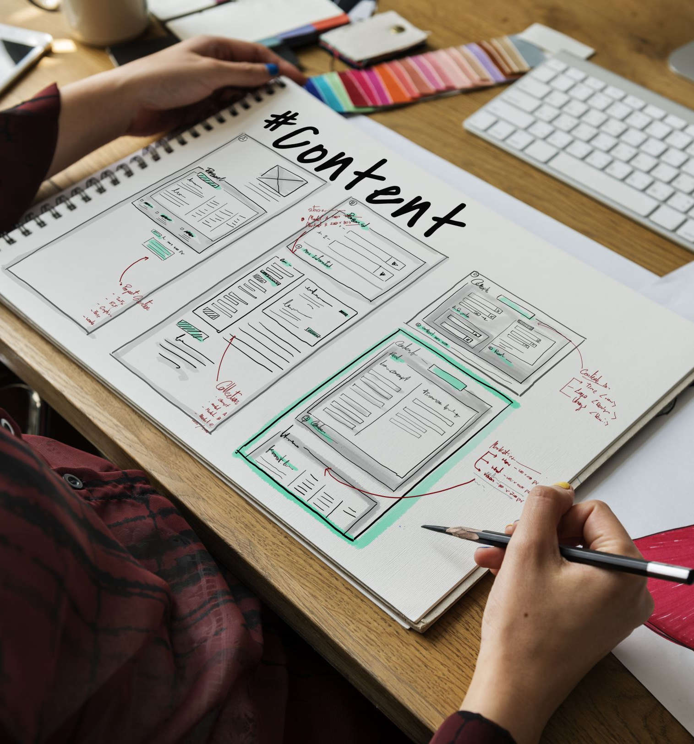
House-keeping
Directions
Presentation Structure
Workbook and group activities
Establishing ground rules

Slide 3

Workbook: activity 1
PRE-MODULE QUIZ

Slide 4
What we will cover
Popular Misconceptions about business
Your business as an asset
Using Mental Models (for understanding how your business works)
The anatomy of Business growth

Slide 5
At the close of the session we will be able to:
View our business as an asset
1
Describe different models for understanding how a business works
2
Utilize at least one mental model to explain the way businesses work
3
Understand the importance of the entrepreneurial mindset to entrepreneurial success
4

Slide 6
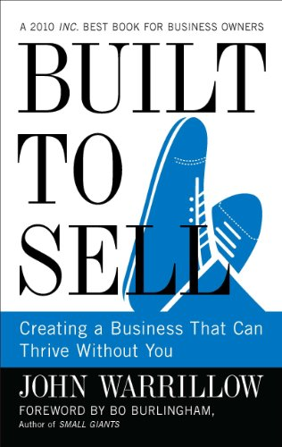
This week’s book recommendation
Kindle - $14.99
Hardcover - $9.35 (Used)
Audiobook - $20.79
pdfdrive.com - FREE

Slide 7
Popular Misconceptions
….about starting/running a business
Section 1

Slide 8
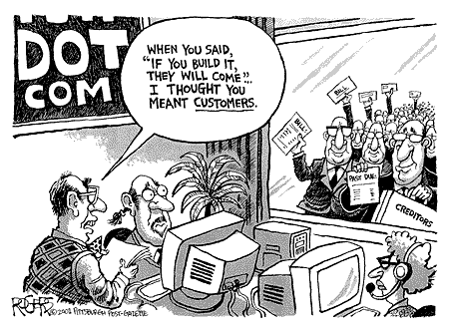
Popular Misconception # 1
Treat and a half/”Brawta”
Build it and they will come
“The biggest mistake businesses make
when trying to get traction is failing to
pursue traction in parallel with product
development.”

Slide 9


Popular Misconception # 2
Building a business around your passion guarantees success
Consultant
Baker
Designer
Software Developer
Hair Stylist
Technician
FOCUS:
Owner’s skills sets;
Owners Interest

Slide 10
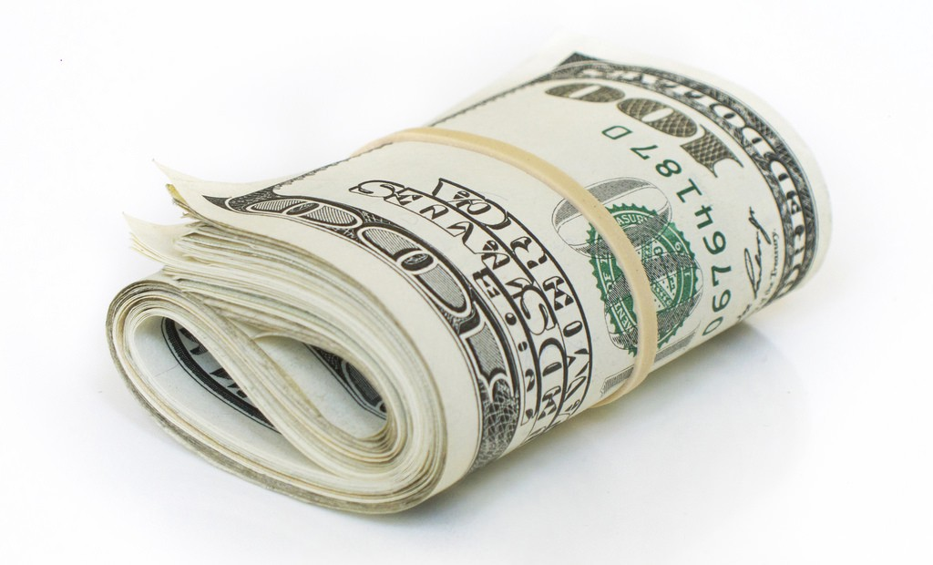
Popular Misconception #3
More money = Better chance of success
OPTIONS
PITFALLS
Loans
Angels
Venture Capital
Bootstrapping
Kills Creativity
Removes focus from clients/places focus on the funder

Slide 11

What business is not
BUSINESS
SALES
An income stream
BUSINESS

Slide 12
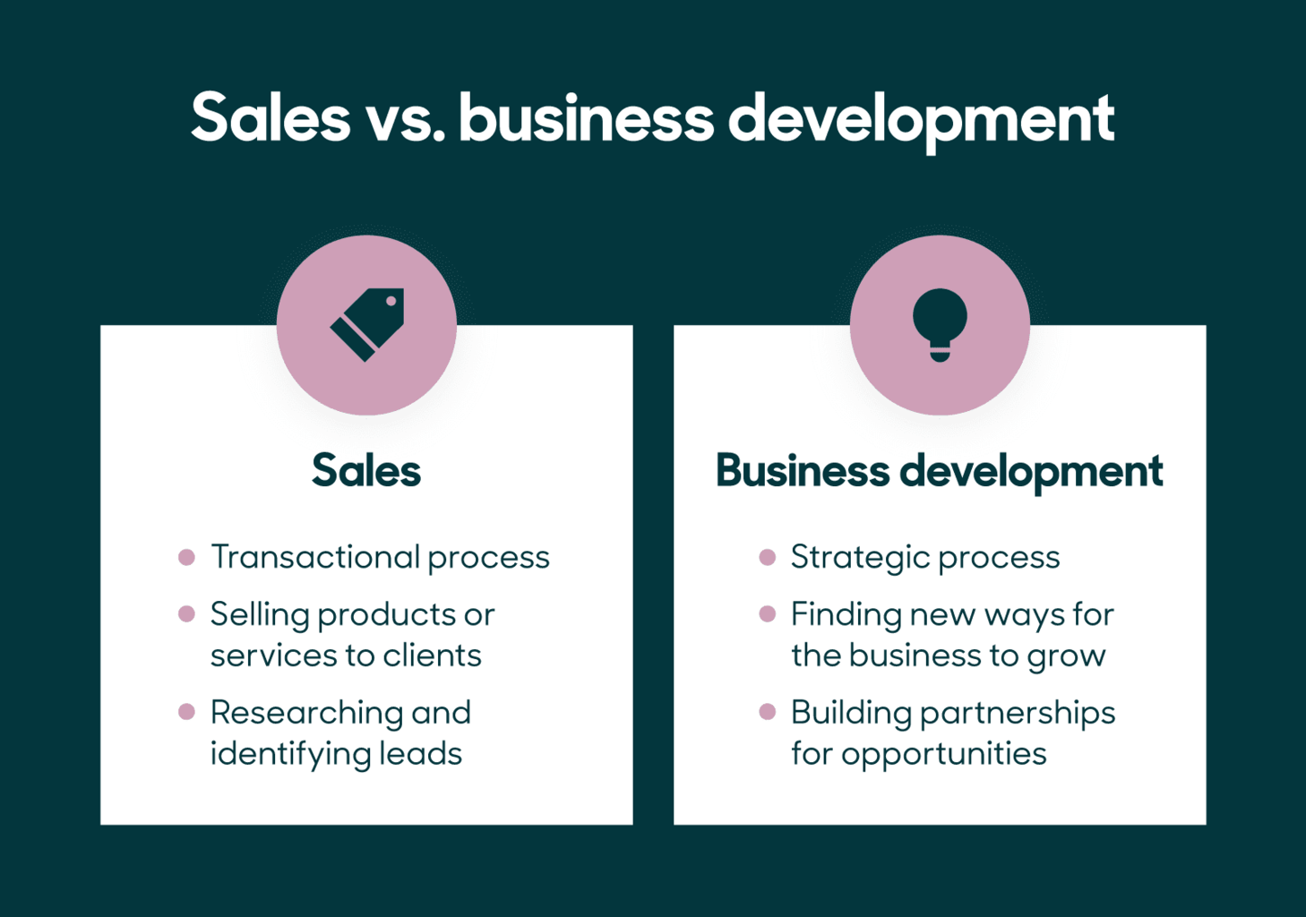

Slide 13
Your business as an asset
Section 2

Slide 14

Let’s discuss
WHAT IS AN ASSET?

Slide 15
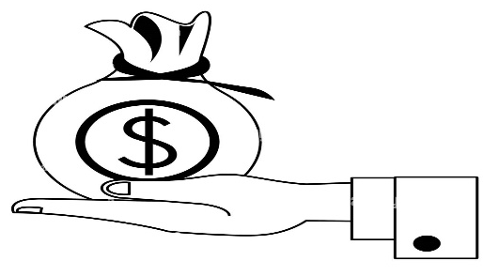
What is an asset?
An asset is anything that has current or future economic value to a business.
For businesses, assets include everything controlled and owned by the company that's currently valuable or could provide monetary benefit in the future. Examples include patents, machinery, and investments

Slide 16


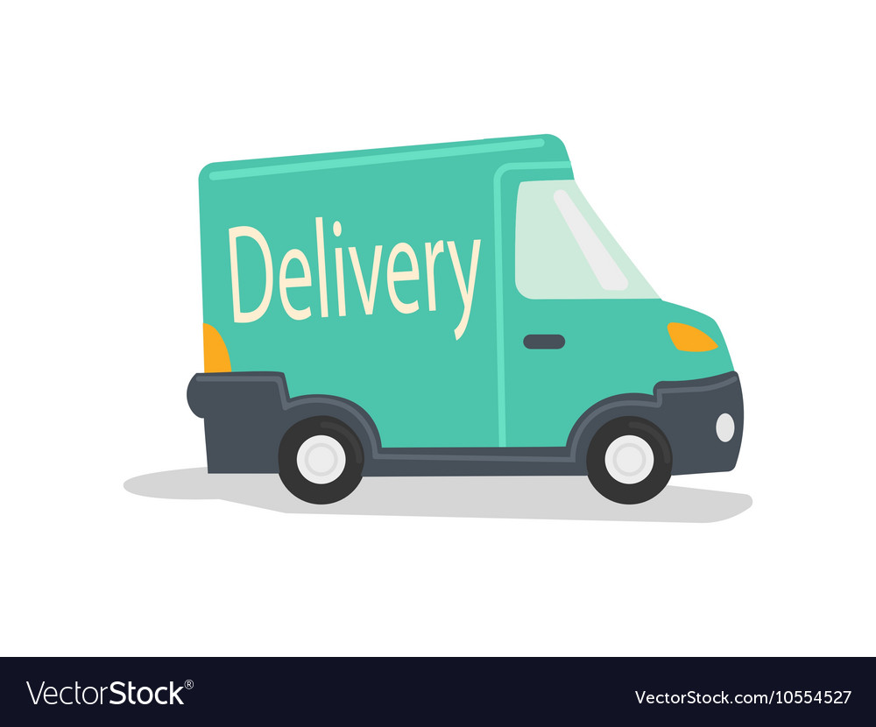


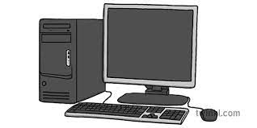
YOUR BUSINESS……
Has assets
As an asset
Brand Reputation
Intellectual Property – Patents, Copyrights, trademarks, trade secrets
Customer Data/Big Data
Systems – structure, processes, procedures
Long term Contracts/Agreements
Goodwill
Knowledge/Expertise (Documented)

Slide 17
BUSINESS AS AN ASSET
For a business, there must be the ability to duplicate/replicate.
Institutional Knowledge (Example of Parkers)
Do not build a business around your or your employees’ skills. It is about what you can duplicate or replicate.
Business owners tend not to be interested in this because they want to personally control every aspect of operations.
Expertise should not reside with you. It must be designed into the operation.
YOUR JOB is to develop a fully SCALABLE asset
It’s not about the income; its about an ASSET that generates a repeatable income.

Slide 18
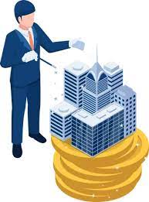
How is a business an asset?
Can have intangible assets such as its brand reputation, customer base and intellectual property (Difficult to measure but can be critical in determining a business’ worth in the market place (market value).
Can provide financial benefits
Has the potential for future growth and value appreciation.
Can generate profits
Can increase in value over time
Can produce a steady stream of income for its owners
Can be a valuable source of collateral for loans and other financial investments.

Slide 19

Why is it important to think asset?
Helps with Long term planning:
Investing in growth opportunities
Innovation – developing new products and services
Building a strong brand reputation
Helps you to prioritize profitability
Looking for ways to minimize expenses and maximize revenue
Ensures business is generating income and providing a return on investment
Helps when you need to finance/sell the business
More likely to keep financial records and build a strong financial history
Makes it easier to get financial loans and sell business if you decide to exit

Slide 20
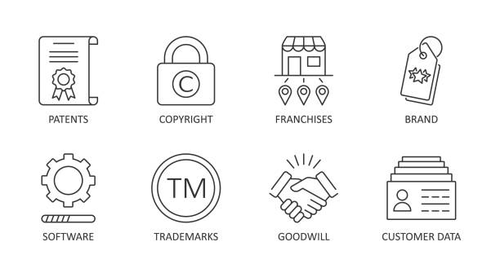
Why is it important to think asset?
Encourages a mindset of innovation and growth:
Look for ways to improve the business
Expand into new markets
Develop new products/services
Stay competitive
Adapt to changing market conditions

Slide 21
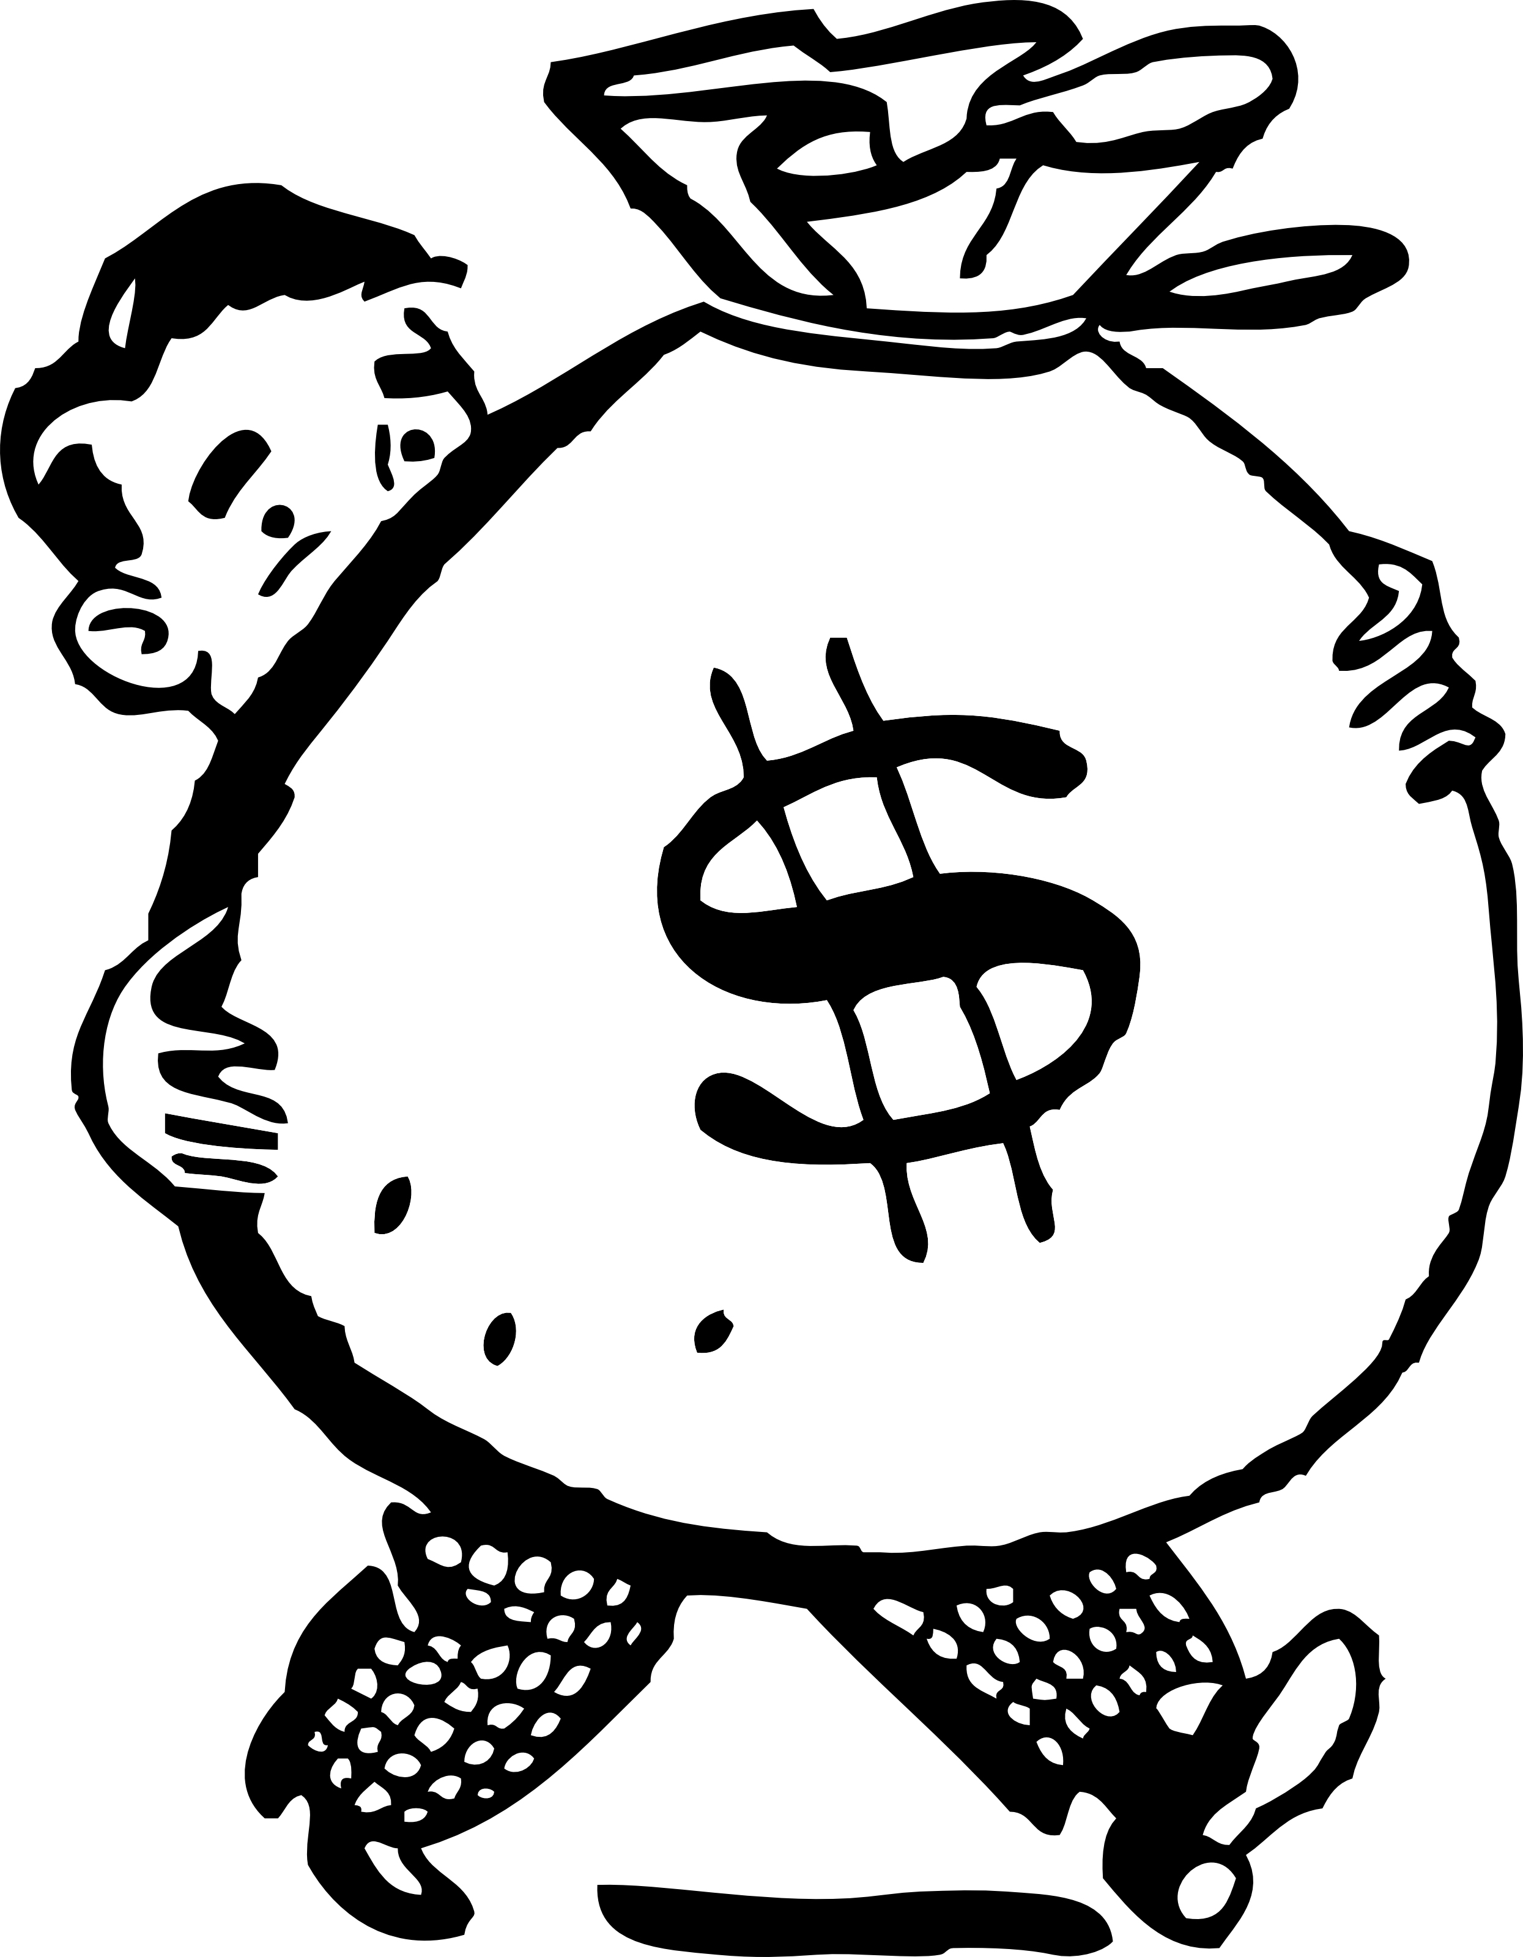
Benefits of treating the business as an asset
Increased value – revenue, profitability, market share (more attractive to potential buyers or investors)
Scalability: Business grows without sacrificing quality or efficiency
Improved credibility: with customers. Suppliers, stakeholders
Flexibility:
Increased access to finance

Slide 22
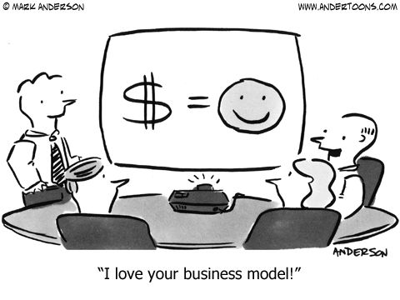
Think ‘sellable’ from the get-go
Market Demand
Profitability
Brand awareness
Policies and Procedures
Team
Intellectual Property

Slide 23
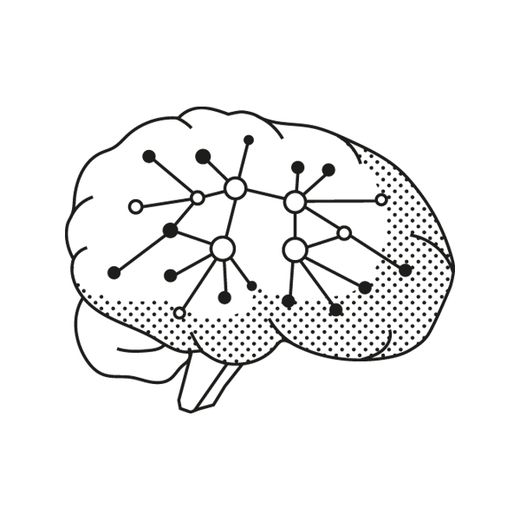
MENTAL MODELS FOR BUSINESS
“To the man with a hammer, everything looks like a nail.”
Section 3

Slide 24

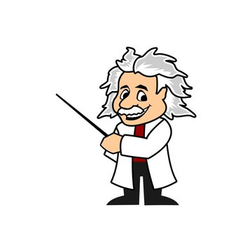
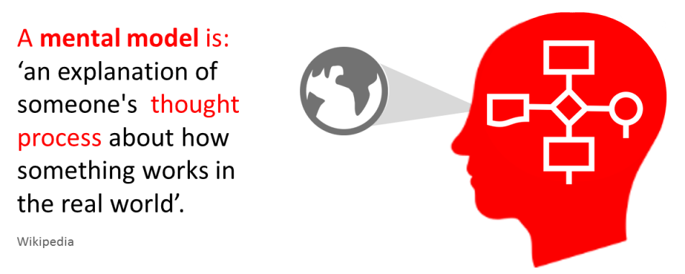
MENTAL MODELS

Slide 25
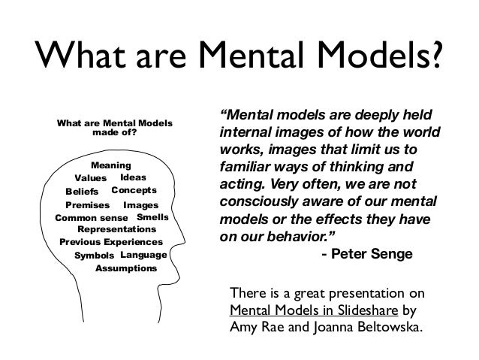
MENTAL MODELS

Slide 26
MENTAL MODELS
How we understand the world; How we simplify complexity
We cannot keep all of the details of the world in our brains, so we use models to simplify the complex into understandable and organizable chunks. Examples are:
Maslow’s hierarchy of needs
Common Knowledge
Stereotyping

Slide 27

4 mental MODELS TO EXPLORE:
Business as a Process
The Quadrant Approach
The Value Chain
The Business Model Canvas

Slide 28

(BUT) WHAT IS A BUSINESS?
Roughly defined, a business is a repeatable process that:
Creates and delivers something of value...that other people want or need...at a price they’re willing to pay....in a way that satisfies the customer’s needs and expectations....so that the business brings in sufficient profit to make it worthwhile for the owners to continue operation.

Slide 29
MENTAL MODEL #1 – BUSINESS AS A 5-PART PROCESS
“Business is not (and has never been) rocket science — it’s simply a process of identifying a problem and finding a way to solve it in a way that benefits both parties.”
– Josh K (Personal MBA)

Slide 30


Most often a non-linear process
Marketing
Sales
Value Delivery
Finance
Value Creation

Slide 31

MENTAL MODEL #1 BUSINESS AS A 5-PART PROCESS
At the core, every business is fundamentally a collection of five Interdependent processes, each of which flows into the next:
Value-Creation. Discovering what people need, want, or could be encouraged to want, then creating it.
Marketing. Attracting attention and building demand for what you’ve created.
Sales . Turning prospective customers into paying customers by completing a transaction.
Value-Delivery. Giving your customers what you’ve promised and ensuring they’re satisfied with the transaction.
Finance. Bringing in enough money to keep going and make your effort worthwhile.

Slide 32

MENTAL MODEL #1 – BUSINESS AS A 5-PART PROCESS
A venture that doesn’t create value for others is a hobby.
A venture that doesn’t attract attention is a flop.
A venture that doesn’t sell the value it creates is a non-profit.
A venture that doesn’t deliver what it promises is a scam.
A venture that doesn’t bring in enough money to keep operating will inevitably close.

Slide 33
WORKBOOK : EXERCISE 2
Think of your business in terms of a five part process. On page 3 of your workbook, answer the questions relating to this process. Complete all 5 elements of the process explaining what each looks like for you/your business at this point.
For example, re Value Creation: What is my existing method for finding out what people clients value? How do I create value?
Write the answers based on what obtains now, not based on what you would like it to be.

Slide 34
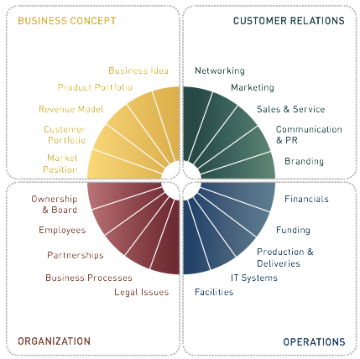
Mental model #2 – the 360 (quadrant) approach

Slide 35
Understanding THE MANAGEMENT FRAMEWORK
Management
Human Resources
Operations
Product/Service Portfolio
Customers/Markets and Sales
Getting customers
Finance
Asset composition
Capital structure
Cost structure
Revenue Model
Credit worthiness
Location
Quality Control
Availability of inputs
Buying and Selling
Getting and doing jobs
Branding
Market positioning
Marketing
Sales and Services
Performance Management
Growth Strategy
Financial Decision-Making
Marketing Strategy
Organization Structure
Policy
Debt structure
Historical/Projected Performance

Slide 36
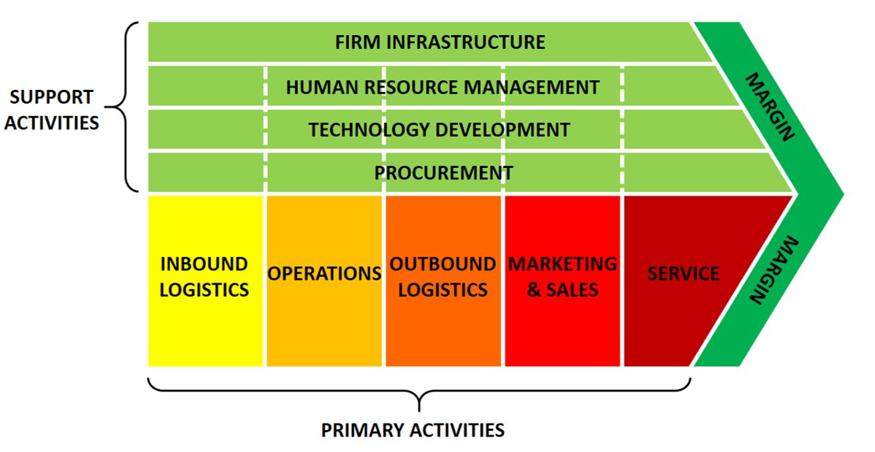
MENTAL MODEL # 3 – value chain

Slide 37
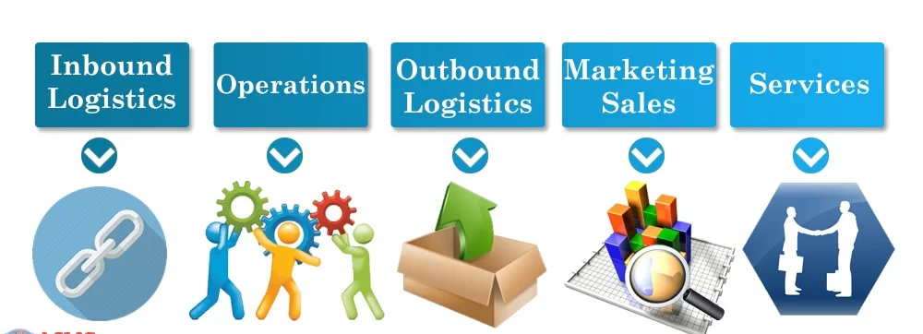
MENTAL MODEL # 3 – value chain (primary activities)

Slide 38
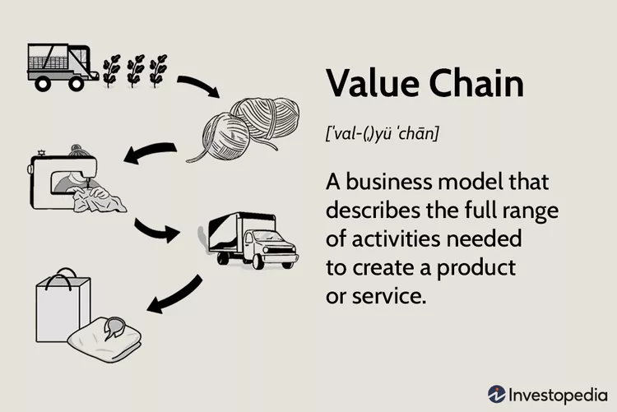
MENTAL MODEL # 3 – THE VALUE CHAIN
A value chain is a series of consecutive steps that go into the creation of a finished product, from its initial design to its arrival at a customer's door.
The chain identifies each step in the process at which value is added

Slide 39

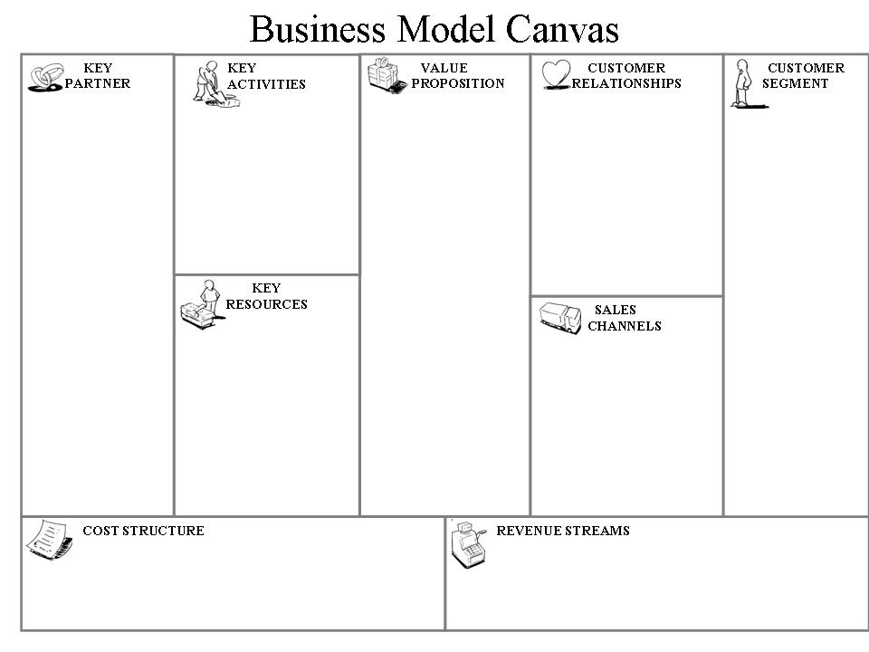
Mental model # 4 – the business model
Essential Building Blocks
A Business’ Key Drivers

Slide 40
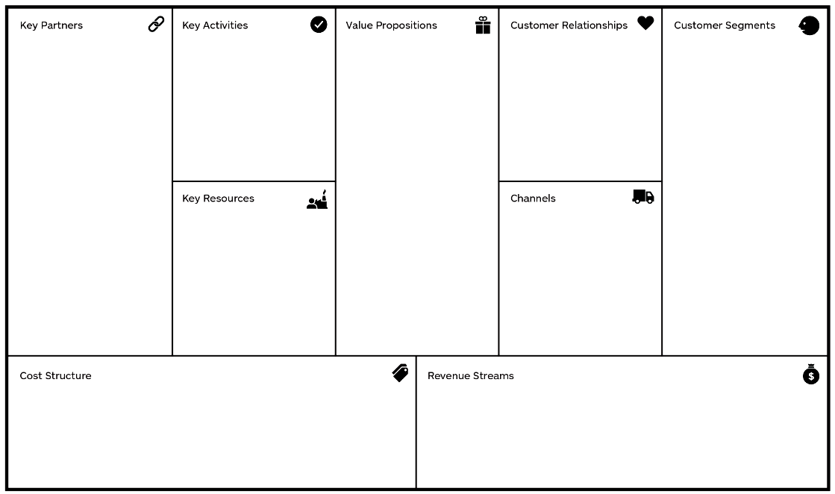
Understanding the Management Framework
Financing
Production and Operations
Management and strategy
Customers and Markets

Slide 41
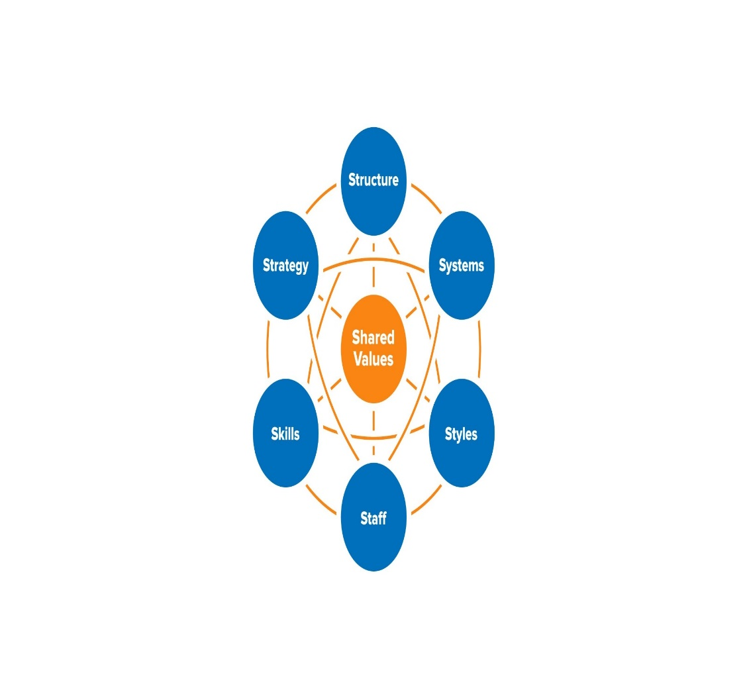
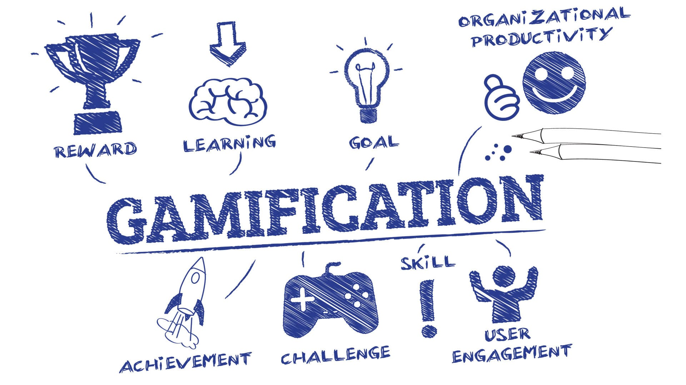
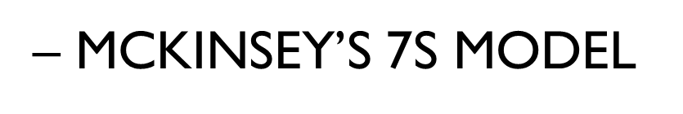
Examples of Other mental models

Slide 42

How to think like an entrepreneur
Section 4. Honing the entrepreneurial Mindset

Slide 43
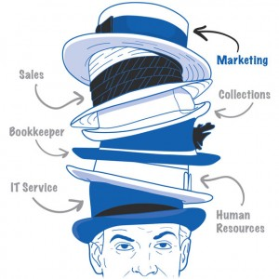
The business owner’s (TOO) many HATS

Slide 44
Your BUSINESS MUST evolve…..
Skill/Talent Centered Enterprise
Product or service- driven Enterprise
Vision-led Enterprise

Slide 45
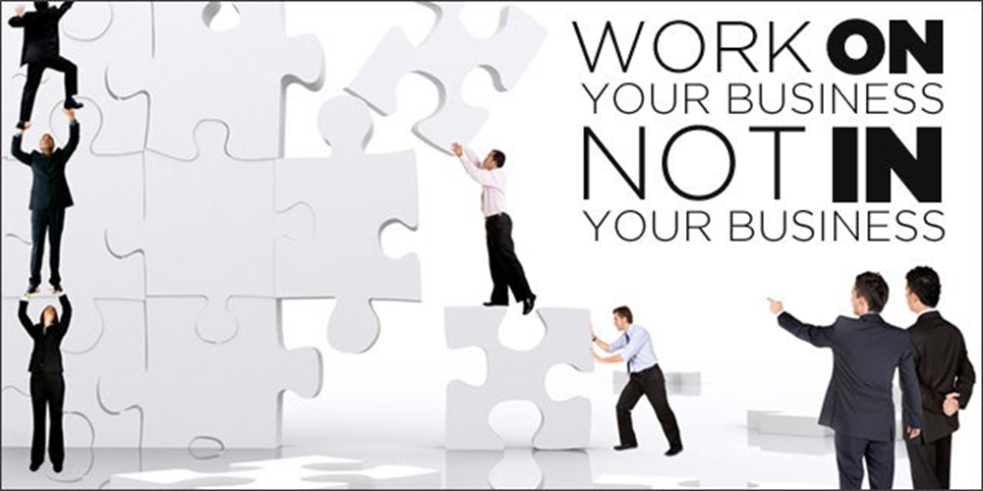
THINK LIKE A BOSS!!!
When you work IN your business, you are working on TODAY’s income.
When you work ON your business, you are working on TOMORROW’s income.

Slide 46

WORKING IN YOUR BUSINESS
Understand that your role in the business changes over time. You may START here:
Setting up supplier relationships
Taking and fulfilling customer orders
Answering the phone
Chasing receivables
Dealing with customer complaints
Cleaning the floors at close of day
OPERATIONAL!!

Slide 47

THINK LIKE A BOSS - WORK ON THE BUSINESS
Understand that your role must evolve if your business is going to grow:
What is your vision for the business?
What’s your plan to get it there?
Who are your key partners?
What key activities should you be undertaking?
What are your major revenue drivers?
What are your cost drivers?

Slide 48

Think like a boss!!!
Know your numbers
How much does it cost you to get new customers?
What is the size of your customer base
How many of your customers are you retaining, how many are you losing?
What is your next growth move?

Slide 49

DEFINITION - Mind-set
“ Mental attitude or inclination”
Entrepreneurial Mind-set:
“Entrepreneurial mindset: The inclination to discover, evaluate and exploit opportunities”

Slide 50

1. self efficacy
The belief we have in our own abilities, especially in our ability to achieve our goals and complete tasks successfully.
“Believe you can and you are half way there.”
- - Theodore Roosevelt (26th US President)

Slide 51
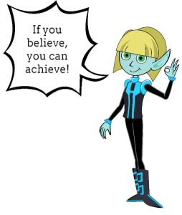
self efficacy
“People's beliefs about their abilities have a profound effect on those abilities. ..People who have a sense of self-efficacy bounce back from failure; they approach things in terms of how to handle them rather than worrying about what can go wrong.”

Slide 52
CAN-DO
They believe in a yet-to-be-made future that can substantially be shaped by human action.
The Key is The Mind. Success in entrepreneurship is not about being the smartest. It starts with a belief by the entrepreneur that he/she is able.

Slide 53
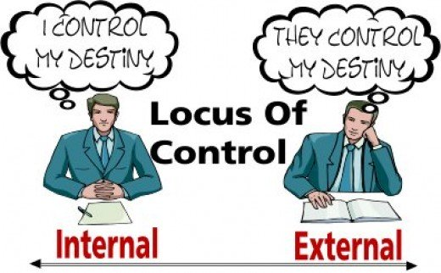
2. locus of control
The degree to which people believe that they, as opposed to external forces, have control over the outcome of events in their lives.
“If it’s going to be it’s up to me””

Slide 54
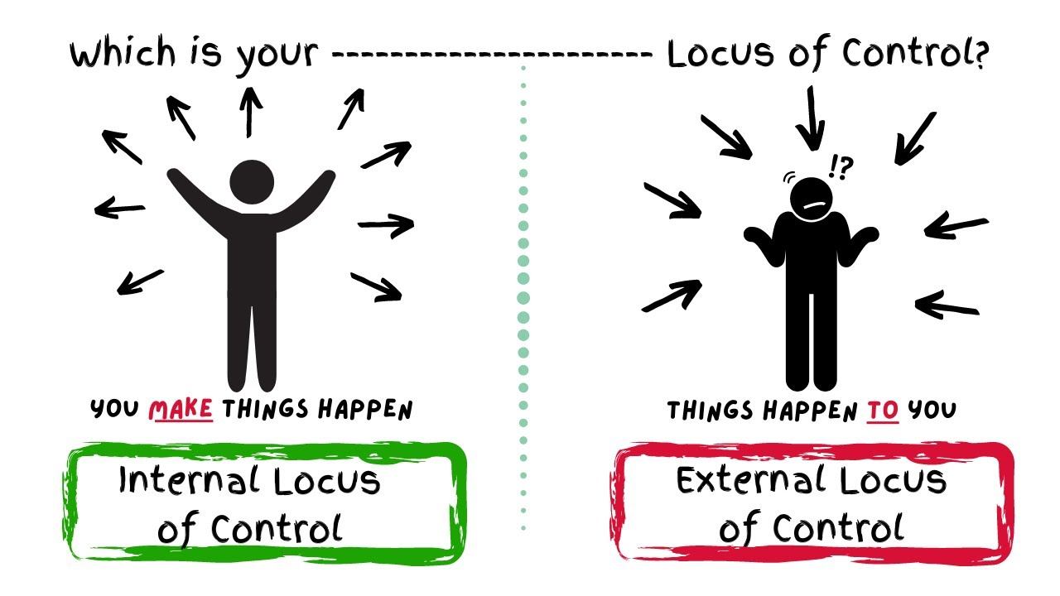
2. LOCUS OF CONTROL

Slide 55
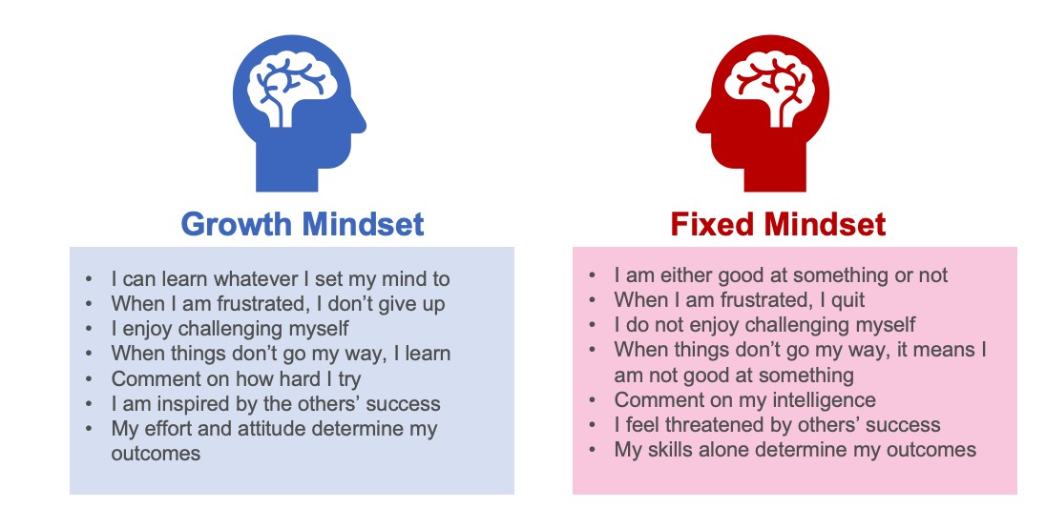
4. Growth mindset

Slide 56
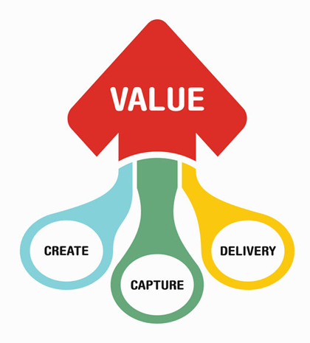
THINK VALUE
A minimum viable product, MVP is a product with enough features to attract early adopters.
Allows you to collect validated learning
MVP is important because:
Want to release a product as early as possible
Test an idea with real users
Learn what resonates with the market

Slide 57

HOW TO THINK LIKE AN ENTREPRENEUR: - HEALTHY RISK-APPETITE

Slide 58


THINK PROBLEM SOLVER
Inherent in every problem is an opportunity for creating value.

Slide 59
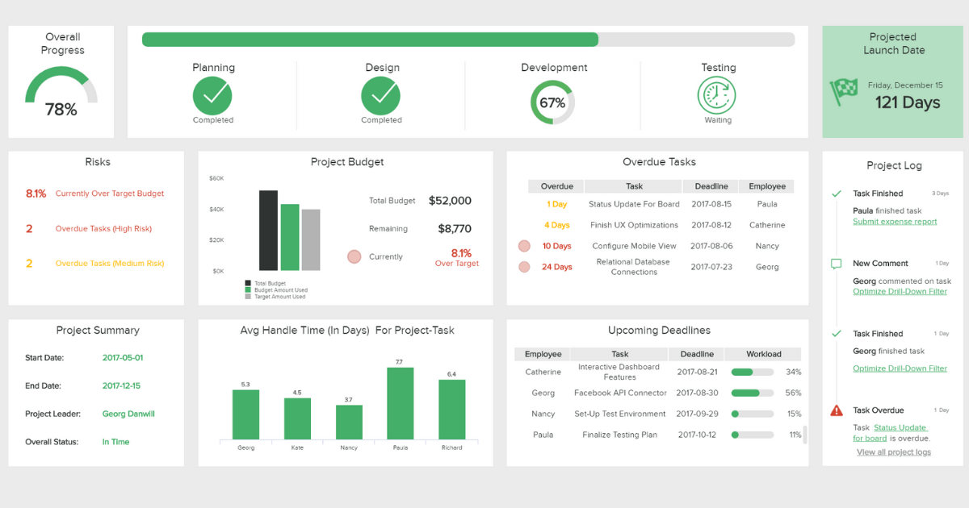
Think management: What’s on your Dashboard?
Non-financial
Financial
Customer Feedback
Customer Retention rate
Customer Referrals
Customer satisfaction
Inventory Turnover Ratio
Net Promoter Score
Cost of Funds
Gross Profit
Breakeven
Sales and revenue run rate
Cash burn
Working Capital

Slide 60
Entrepreneurial Thinking
Imagine the end,
Create the means

Slide 61
The anatomy of A business
Understanding the process of business growth
Section 5

Slide 62

Think of your business as a body with various parts
Skeleton: Organizational structure, systems, processes – The foundation. That which you build on
Muscles: Resources and Employees – Responsible for carrying out the daily operations.
Organs: Departments and teams
Bloodstream: Cash flow and resources
Nervous system: Communication channels

Slide 63
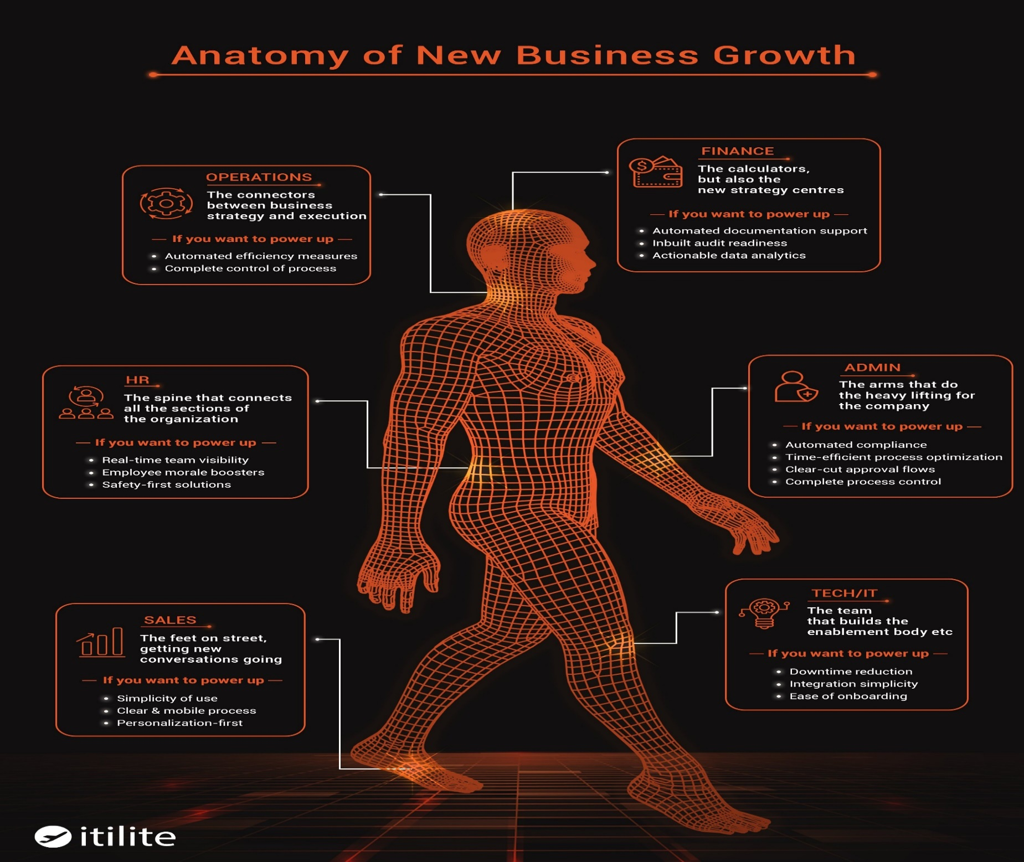
{"a":5,"d":"B","h":"www.canva.com","c":"DAFfwpYnR-o","i":"gRhlpd0a4FEw2GoI8CzldQ","b":1681180831650,"A?":"A","A":{"C":"#ffffff"},"B":1920,"C":1080}
Credit: Itilite.com

Slide 64

What makes a business scalable?
Automation/Technology
Standardization
Repeatability
Low margin costs
Outsourcing
Leverage
Network Effects

